Slide 1
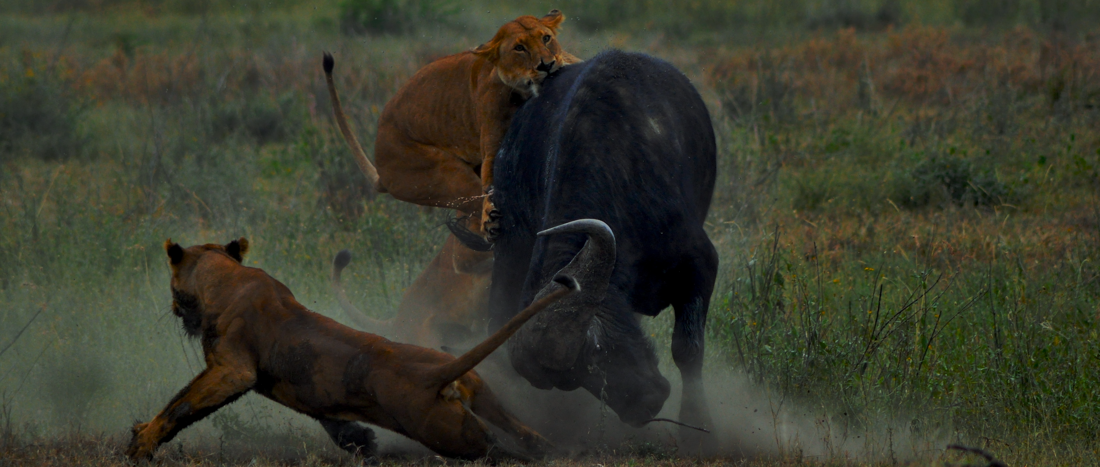
The role of behaviour in predator – prey interactions
Daniel Fortin, Maxime Fraser Franco, Pierre-Olivier Montiglio
Sentinelle Nord summer school
Notes:
Hi everyone, welcome to the summer school and to this work package.
We are super excited to be here to work on the role of behaviour in predator prey interactions with you today.

Slide 2



Who we are
Daniel Fortin (Professor at Laval University)
Behavioural mechanisms driving animal distribution in landscape
Daniel’s page
Maxime Fraser Franco (PhD candidate at UQAM)
Drivers and consequences of individual variation in predator-prey interactions
Maxime’s page
Pierre-Olivier Montiglio (Professor at UQAM)
Evolutionary biology of interacting phenotypes
PO’s page
Notes:
First, we wanted to introduce ourselves a bit more.
…

Slide 3
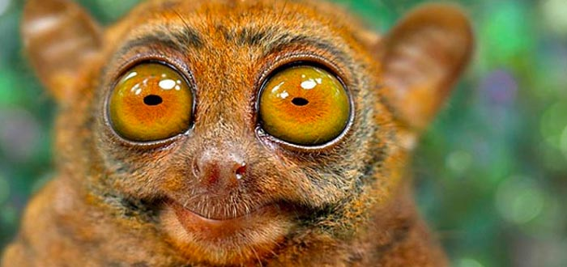
Who are you?
What is your name?
Where do you come from?
What are you working on?
What are you looking for in this summer school?
Notes:
… Now your turn, let us know who you are.
We also wanted to make sure everyone knows you.
So we just prepared a few simple points on which we want to hear you

Slide 4
Objectives of this work package
Learn to model the optimal predator/prey behaviour in response to interactions
Learn to analyse the structure of predator/prey behavioural variation
Learn to quantify selection on behaviour
Tackle key questions at intersection of two approaches using TrophEE data
Notes:
Today, we will have the following objectives…
We will first learn to use two different approaches to investigate the role that behaviour plays during predator prey interactions.
One relies on formal / analytical models that were initially developed in economy to explain behaviour.
The other relies more on statistical models, and it was developed to predict changes in behaviour over time.
We are going to provide a quick background on each approach, and to let you experience them first hand in R using some tutorials that we developed for you.
And we are going to close off this work packages by suggesting some areas for collaborations among ourselves that we can start during the week during the data that we will generate running after each other.
I think that several of these collaborations could be publications if we stick with it once the summer school is over.

Slide 5
THE interaction among organisms
Involves consumption of resources, includes herbivory and parasitism
Important at every scale:
Individual distribution in space / time
Population density and dynamics
Community structure and stability
A central agent of micro and macro evolution, leads to tight coevolution of predators and prey
Notes:
Since you have all registered to a summer school on predator prey interactions, it is probably safe to assume that you are all almost sold on the idea that predator prey interactions are among the most important interactions out there.
All interactions are probably important in ecology, but predator prey interactions have been the most studied for their effects on lots of things.
This is because we recognize that these have important consequences at every scale.
These interactions determine the distribution and the characteristics of individuals within populations (in prey and in predators).
At the scale of populations, these interactions determine strongly the density and the dynamics of births and deaths.
You can think of the classical work on snowshoe hares and lynxes population cycles that started here in Canada.
And at the scale of whole communities, predator prey interactions shape structure and the stability of communities, both through direct, indirect, or cascading effects.
For example, there was a huge debate about the importance of bottom-up vs top down effects in regulating communities in the 70s and 80s, and we have simple predator removal experiments showing big impacts on communities.
We have whole books dedicated to trait-mediated indirect effects or trophic cascades.
Predation is also thought to be one of the central engine behind natural selection and biological evolution.
Researchers have worked on understanding the coevolution among predators and prey for a while now.

Slide 6
The evolution of predator – prey interactions
Explaining/predicting changes in predator and prey traits over time
5 stages: Detection, Identification, Approach, Subjugation, Consumption
All stages affected by prey and predator traits (physiology, sensory, movement, morphology)
Notes:
So you will find a lot of studies aiming at ‘understanding’ the evolution of predator prey interactions out there.
I think that this is important to define before we embark on this type of work.
Here I’ll offer the definition that Peter Abrams uses (you have the reference here)
It mean explaining and predicting changes in predator and prey traits over time (over generations) in habitats where they cooccur and interact.
Now if we want to really explain and predict these traits changes, it is important to break down an interactions into its components.
According to Lima and Dill, you can decompose an interactions between a predator and a prey into 5 main stages…
The first stage is detection of the prey by the predator (and vice versa in some systems).
The second stage involves the predator and sometimes the prey identifying each other as such.
The third stage is called the approach, but it involve chases, attacks, evasive movement from prey, etc. This is usually what we think of when we think of predator prey interactions.
The fourth stage happens if the predator captures the prey. This is where the predator will handle its prey and the prey fight to escape.
Finally, the last stage is the consumption of the prey by the predator.
All these stages are affected by the traits of predators and prey.
These traits can be sensory traits, cognitive traits, you also have morphological traits, or physiological traits, and of course, you have behaviour.
I would say that behaviour is also potentially affecting all these stages, because prey and predators have to make decisions between different behavioural options (for example to run or not).

Slide 7

A first model for predator – prey interactions
Prey growth rate
$$\frac{dN}{dt}=NrN−CN$$
$$\frac{dP}{dt}=P(rPCN−DP)$$
Number of prey
Prey death rate
Capture rate
Number of predators
Predator death rate
Predator growth rate
Notes:
To formalize a bit the role that traits , asn espcially behaviours, can play during the interaction, lets start with a crude model, a pretty classical one that was defined in the 90s.
Again, you have the reference here.
This is a model that aims to predict the demographic consequences of predator prey interactions.
It predicts the number of prey and of predator individuals over time as a function of a few parameters.
For the prey, you have the growth rate rn (we need to multiply it by the number of prey to get the number of new individuals that are born.
To this number of individuals we remove the number of individuals that were eaten by predators.
This number is determined by the per capita capture rate C multiplied by the number of prey.
On the predator side, the number of individuals depends on the predator growth rate rp that is multiplied by the number of prey consumed ( predators use energy from consumed prey to reproduce). The model also has a death rate for predators. Dp
The model is not really the point here, I used it simply to summarize how we think of predator prey interactions.
In this view, the most important parameter to dissect is the predator’s capture rate C, or its functional response, if you replace CN by another function of N.
C is determined by the traits, and behaviour is among them, expressed by predators and prey.

Slide 8
Studying the role of behaviour in predator –prey interactions
Predators express foraging modes to maximize capture rate
Active pursuit or sit-and-wait/ambush modes
Prey antipredatory responses negotiate trade-offs between foraging and safety
alters habitat use and movement
Notes:
For example, predators will use different foraging modes to maximize their capture rates, based on the type of prey that they consume and on the structure of the environment, or on constraints that they might have.
These foraging modes are often plastic and can vary within individuals over time, among individuals. They also vary along a main gradient, going from active foraging, where the predator moves in the environment to detect and locate prey before attacking them, to ambush foraging, where predators stay in a single location and wait for prey to approach enough before attacks.
On the prey side, much of the work on prey behaviour has revolved around the trade-off between foraging and safety.
How to prey find and consume their food while avoiding being consumed themselves.
Again, how much prey emphasize foraging over safety can change within individuals over time, or differ among individual prey.
The exact changes that prey will make to their foraging to improve safety depends on the types of items they consume, on the structure of the environment, and on the foraging mode of the predator.
These changes, resulting only from the presence of the predator (non consumptive effects) are sometime even more important for populations and communities than the removal of individual prey by the predator.
So obviously predator foraging mode interacts with prey behaviour.

Slide 9
Two approaches to analyse behaviour
1) Optimality / Evolutionary Stable Strategy
Analyses the costs and benefits of different strategies or tactics that organisms can express
Identifies the stable final evolutionary outcome
Notes:
And so going back to our main question, how do predator and prey behavioural traits change over time when they interact, researchers have used two main approaches…
The first one, optimality, tries to analyse the costs and benefits of different strategies or tactics using econometric modelling.
The goal when using the optimality approach is to analyse the fitness costs and the benefits of different strategies or tactics to identify the optimal behaviour or how changes in the environment or parameters of the interactions should affect the optimal behaviour.
The measure of fitness that we use are usually proxies such as the amount of energy acquired per unit of time, or the level of risk.
These proxies are often very far from the lifetime reproductive success.
We use our analysis of these optimal behaviours to predict the actual behaviour that should have evolved in a given context (assuming that evolution has taken place without any constraint) and whether this optimum displays a stable equilibrium, where traits of prey and predators should stabilize.

Slide 10
Two approaches to analyse behaviour
1) Optimality / Evolutionary Stable Strategy
Analyses the costs and benefits of different strategies or tactics that organisms can express
Identifies the stable final evolutionary outcome
2) Quantitative genetics / interacting phenotype theory
Combines quantitative genetics and phenotypic selection
Emphasizes continuous variation in traits and microevolutionary dynamics within populations / species
Notes:
The second approach combines an analysis of the ability of traits to evolve (quantitative genetics) with the framework we use to look at selection on phenotypic traits.
This combination does not really have a set name, I’ll go with interacting phenotypes approach.
Unlike the optimality approach, the interacting phenotype approach is a series of statistical models describing how behavioural traits should change in mean and variance from one generation to the next.
So its emphasis is more on the speed of evolution, or on the evolutionary trajectory of the traits over time, as a function of selection pressures.
This approach is THE reason we developed linear models in biology (thanks to Fisher, Pearson, etc). So it might look ‘just’ like a statistical analysis of behavioural traits, but in fact it offers a mathematical framework to describe evolution.
The two approach are similar in some area, and complementary in others. So I do not think that you can really understand the role of behaviour in predator prey interaction without one or the other.

Slide 11
Objectives of this work package
Learn to model the optimal predator/prey behaviour in response to interactions
Learn to analyse the structure of predator/prey behavioural variation
Learn to quantify selection on behaviour
Tackle key questions at intersection of two approaches using TrophEE data
Notes:
OK, so here is a quick recap about what we are going to do today… the goal of it all is to give you some computational tools to use the two approaches to analyse the data we are going to generate this week!s

